Slide 1
IBM University Engagement Project Submission
“Exploring the Power of Agentic AI with IBM Granite and LangFlow”

Slide 2

Project Tile –AI Interview Trainer Agent
Domain of Project –Education
Student Name | Recent Passport Photo | Email ID | Mobile number [WhatsApp]
Siliveri poojitha |  | poojithasiliveri2345@gmail.com | 9440863378

Slide 3
Problem Statement -
Problem Statement No.22 – Interview Trainer Agent
The Challenge – An Interview Trainer Agent, powered by RAG (Retrieval-Augmented Generation),
prepares users for job interviews by generating tailored question sets and preparation strategies based on their profile name, experience level, and job role. It retrieves role-specific interview questions, industry expectations, behavioral scenarios, and HR guidelines from recruitment portals, professional networks, and company interview databases. Users can input their resume or job title, and the agent provides targeted questions, model answers, and improvement tips. It supports both technical and soft skill assessment, ensuring a comprehensive interview prep experience. This AI-driven assistant builds user confidence, sharpens responses, and increases success rates in competitive hiring environments. Technology – Use of IBM Cloud Lite services / IBM Granite is mandatory.

Slide 4
Proposed Solution -
Proposed Solution: AI-Powered Interview Trainer Agent
The proposed solution is an AI-powered Interview Trainer Agent built using LangChain, IBM watsonx.ai, and IBM Granite Models to provide
personalised, real-time interview preparation guidance. The system addresses challenges in interview readiness, answer quality, and career confidence throughan intelligent, modular architecture.
At its core, the solution uses a Retrieval-Augmented Generation (RAG) pipeline to fetch accurate, role-specific knowledge from a curated knowledge base covering real interview questions, STAR behavioural scenarios, HR recruitment guidelines, and industry-specific interview formats. This data is embedded using all-MiniLM-L6-v2 and stored in ChromaDB, enabling the system to retrieve and inject the top-5 most relevant documents into every IBM Granite prompt — ensuring grounded, factual, and context-aware responses.
The system consists of four key agents:
Question Generator Agent retrieves role-specific context via RAG and generates a balanced set of tailored interview questions — 40% technical, 40% behavioural, and 20% HR — adapted to the candidate's job title, experience level, and skill set.
Answer Evaluator Agent analyses the candidate's submitted answer using IBM Granite and delivers structured feedback including a score out of 10, strengths, areas for improvement, a model answer, and a STAR format check for behavioural questions.
Preparation Planner Agent generates a personalised 4-week interview preparation plan with structured daily activities based on the candidate's role, experience level, and identified skill gaps.
Resume Parser Agent automatically extracts structured information — skills, experience, education, and contact details — from uploaded PDF, DOCX, or plain text resumes to build a rich candidate profile.The solution includes a user-friendly Web UI (built with Flask and served as a single-page dark-mode application) and a Rich interactive CLI that allow candidates to generate questions, submit answers for evaluation, and receive their preparation plans. The Web UI visualises question sets, feedback scores, and weekly prep activities in a clean, accessible interface.
LangChain is used to orchestrate the retrieval and generation workflow, while IBM watsonx.ai ensures scalable model deployment, inference, and AI governance. IBM Granite (ibm/granite-4-h-small) powers natural language understanding, reasoning, personalisation, and structured output generation across all four agents.
Overall, this solution delivers an end-to-end intelligent interview preparation assistant that empowers job seekers — especially students and freshers — through personalised question generation, real-time answer feedback, structured preparation planning, and full accessibility on IBM Cloud Lite at zero cost.

Slide 5
Technology Used
Langflow – Visually design and orchestrate the multi-agent workflow
IBM Granite (ibm/granite-4-h-small) – Language understanding,
reasoning, and personalization for questions, evaluation, and prep plans
IBM Cloud – Reliable, secure, scalable infrastructure to deploy
the Interview Trainer Agent
RAG – Fetches role-specific knowledge first,
making answers more accurate and trustworthy
IBM watsonx.ai – Model deployment, embeddings, and AI governance
ChromaDB – Vector database for RAG-based interview knowledge retrieval
Flask – REST API and web UI to deliver the prep outputs

Slide 6
Langflow component Used -
Chat Input — Interface where candidates enter their profile details, job title, skills, experience level, or submit answers to interview questions for real-time AI evaluation.
IBM watsonx AI
Agent — Processes candidate input using IBM Granite models to generate personalised interview questions, structured answer feedback, and 4-week preparation plans.
IBM Granite Model (ibm/granite-4-h-small) — Fast, efficient model for real-time interview question generation, answer scoring, and preparation planning with instruction-tuned prompts.
Chat Output — Displays AI-generated responses such as tailored question sets, answer evaluation scores, model answers, improvement tips, and weekly preparation plans.
File Component — Stores and retrieves candidate resumes (PDF/DOCX/TXT), curated knowledge base JSON files, and the ChromaDB vector index for RAG-based document retrieval.
RAG Retriever — Queries the ChromaDB vector database using all-MiniLM-L6-v2 embeddings to fetch the top-5 most relevant interview documents before every Granite generation call.
Resume Parser Component — Automatically extracts structured candidate data — name, email, skills, experience, education — from uploaded resume files to build a rich profile for personalization
.
Prompt Template — Structures the candidate profile summary and retrieved RAG context into instruction-tuned prompts optimised for IBM Granite's reasoning and generation format.
REST API Component (Flask) — Exposes endpoints (/questions, /evaluate, /plan, /full-session) to connect the front-end Web UI and CLI to the backend agent pipeline.

Slide 7
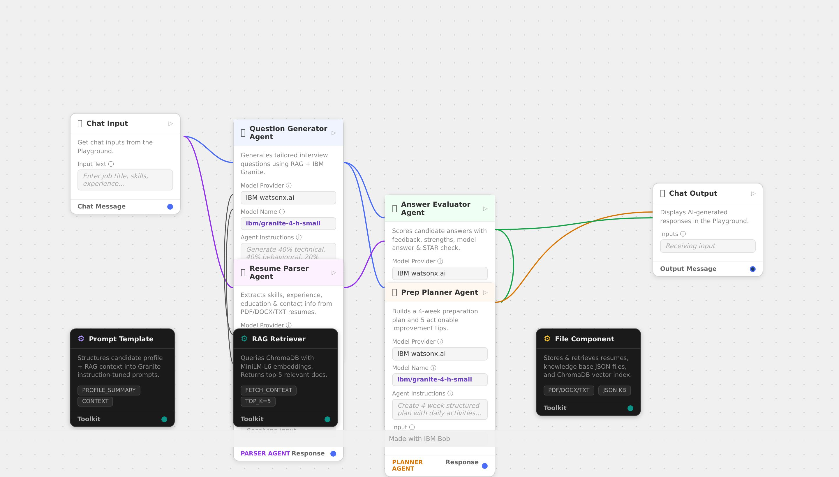
Langflow workflow -

Slide 8
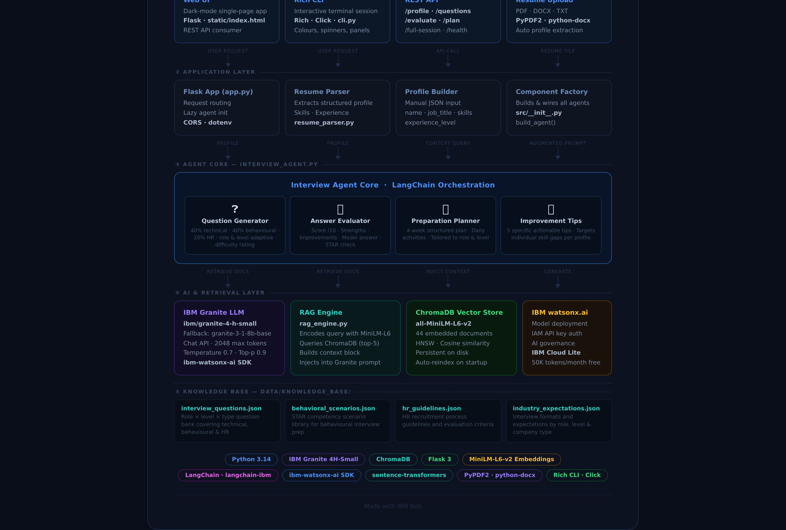
Architecture blueprint

Slide 9

Role of Agentic AI in the solution
The AI Interview Trainer Agent uses Agentic AI through four specialised agents — Question Generator,
Answer Evaluator, Preparation Planner, and Resume Parser — each powered by IBM Granite (ibm/granite-4-h-small)
on IBM watsonx.ai, orchestrated via LangChain.
Unlike a simple chatbot that responds to one prompt, these agents plan, reason, retrieve, and act
autonomously across multiple steps. Before every generation, each agent invokes the RAG tool to
query ChromaDB and retrieve the top-5 most relevant documents from the curated knowledge base
— grounding every response in real facts rather than hallucinations.
The Question Generator autonomously reasons over the candidate's role, level, and skills to produce
a calibrated mix of technical, behavioural, and HR questions. The Answer Evaluator independently
decomposes evaluation into score, strengths, improvements, model answer, and STAR check — without a human
defining the rubric. The Preparation Planner constructs a full 4-week roadmap with daily activities
in a single multi-step reasoning chain. The Resume Parser extracts structured candidate data from
any unstructured PDF, DOCX, or TXT file autonomously.
This demonstrates all five core Agentic AI capabilities — autonomous reasoning,
tool use, multi-step planning, context-aware personalisation, and graceful
fallback to Demo Mode — making the system a true intelligent agent rather than a static question bank.

Slide 10
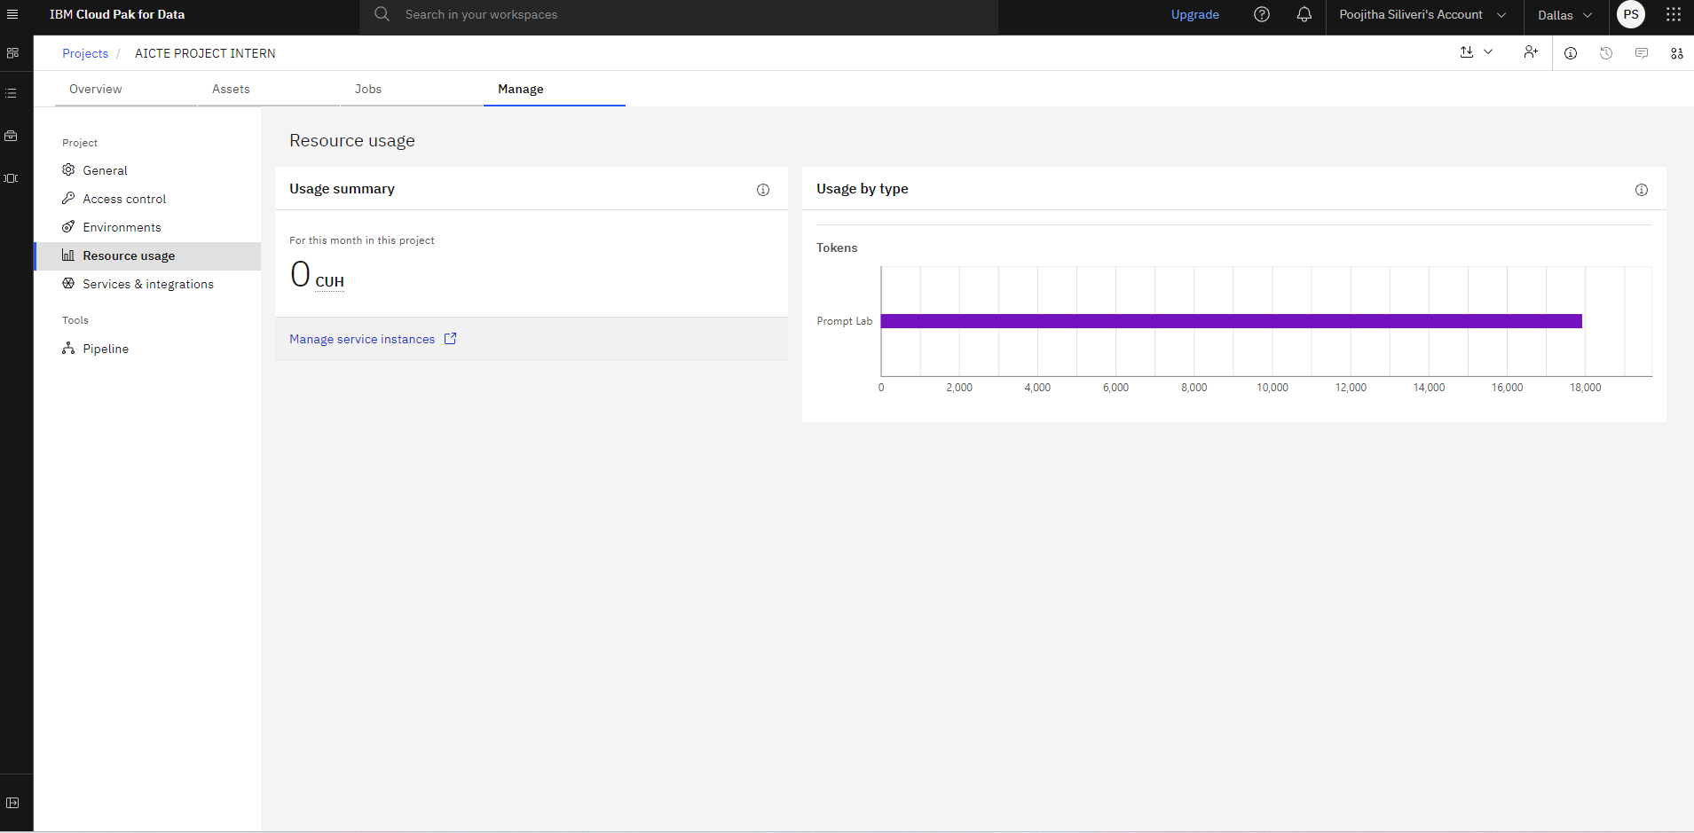
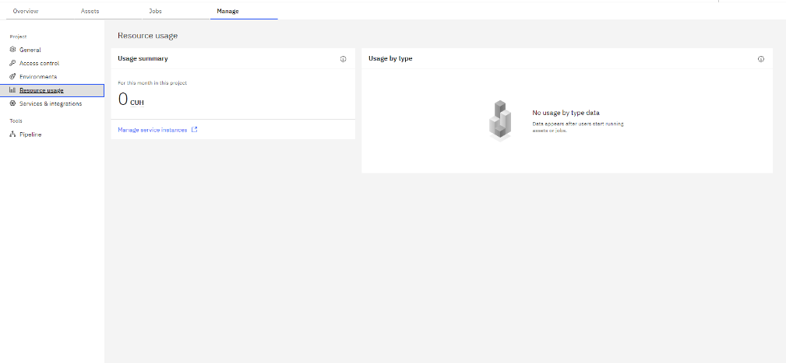
Token Usage
18,000 token are used
Before Prompt
After the Prompt
·
·
·

Slide 11
Novelty and Uniqueness
The proposed AI Interview Trainer Agent stands out by combining Agentic AI, RAG, and personalisation into a single intelligent system.
Multi-Agent Intelligence — Instead of a single chatbot, four specialised agents — Question Generator, Answer Evaluator, PreparationPlanner
Resume Parser — collaborate to deliver accurate, context-aware, and role-specific interview preparation guidance.
RAG-Based Accuracy — Integrates real-time knowledge retrieval from ChromaDB with IBM Granite generation, reducing hallucinations and ensuring every question, feedback, and plan is grounded in verified, curated content.
Hyper-Personalisation — Tailors interview questions, answer evaluations, and preparation plans based on the candidate's job title,experience level, skill set, years of experience, and resume content.
Real-Time Feedback Loop — Delivers instant, multi-dimensional answer evaluation — score out of 10, strengths, improvements, model answer,and STAR check — enabling candidates to improve with every answer they submit.
Resume-Aware Intelligence — Supports automatic extraction from PDF, DOCX, and plain text resumes, eliminating manual input and enablingdeeper personalisation from the very first interaction.
Career Readiness Focus — Goes beyond question generation to provide a full 4-week structured preparation plan with daily activities and five targeted improvement tips addressing each candidate's specific skill gaps.
Scalable and Enterprise-Ready — Built on IBM watsonx.ai with IBM Granite models and IBM Cloud infrastructure, ensuring responsible AI governance, reliability, and scalability for educational institutions and enterprise use.
This makes the solution a smart, adaptive, and proactive digital interview coach — not just a static question bank.

Slide 12
Git Hub Link
https://github.com/poojithasiliveri2345-cmd/AICTE-ai-trainer-agent

Slide 13
Future Scope
Integration with Job Portals & LinkedIn — The system can be integrated with platforms like LinkedIn, Naukri, and Indeed to automatically fetch the candidate's live job profile, applied roles, and target company details. This will enable the Interview Trainer Agent to generate even more precise, company-specific questions and tailor preparation plans based on real job descriptions and current hiring trends.
AI-Powered Voice Assistant & Multilingual Support — Enhancing the system with a voice-enabled assistant and support for multiple languages will improve accessibility. Candidates can speak their answers aloud and receive spoken feedback, making the solution more inclusive and suitable for diverse populations — especially first-generation job seekers and students in regions with varied linguistic backgrounds across India.
Real-Time Mock Interview Simulation — The system can be extended into a fully interactive mock interview mode where IBM Granite acts as a live interviewer — asking follow-up questions based on the candidate's previous answer, adjusting difficulty dynamically, and simulating the pressure of a real interview environment with a session timer and performance summary at the end
.
Emotion and Confidence Analysis — Integrating computer vision and speech analysis will allow the system to detect the candidate's confidence level, tone, pace, and facial expressions during mock interviews. This will enable the agent to provide feedback not just on what was said but on how it was delivered — a critical factor in real interviews.
Personalised Learning Path with Progress Tracking — The system can be enhanced with a dashboard that tracks the candidate's improvement over time — comparing scores across sessions, visualising skill growth, and automatically updating the preparation plan based on daily practice activity and weak areas identified from past evaluations.
Enterprise & Campus Placement Integration — The platform can be deployed at scale for colleges, universities, and corporate HR teams — allowing institutions to run AI-powered mock placement drives, generate role-specific question sets for bulk candidates, and provide automated evaluation reports to placement officers and hiring managers.
·

Slide 14
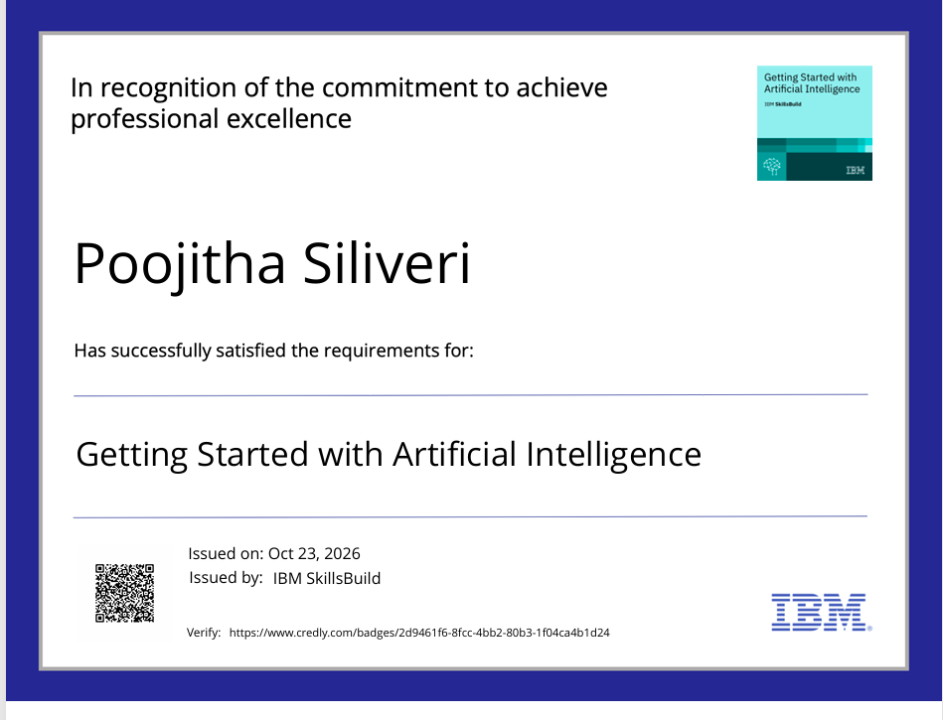
Certificates Earned:

Slide 15
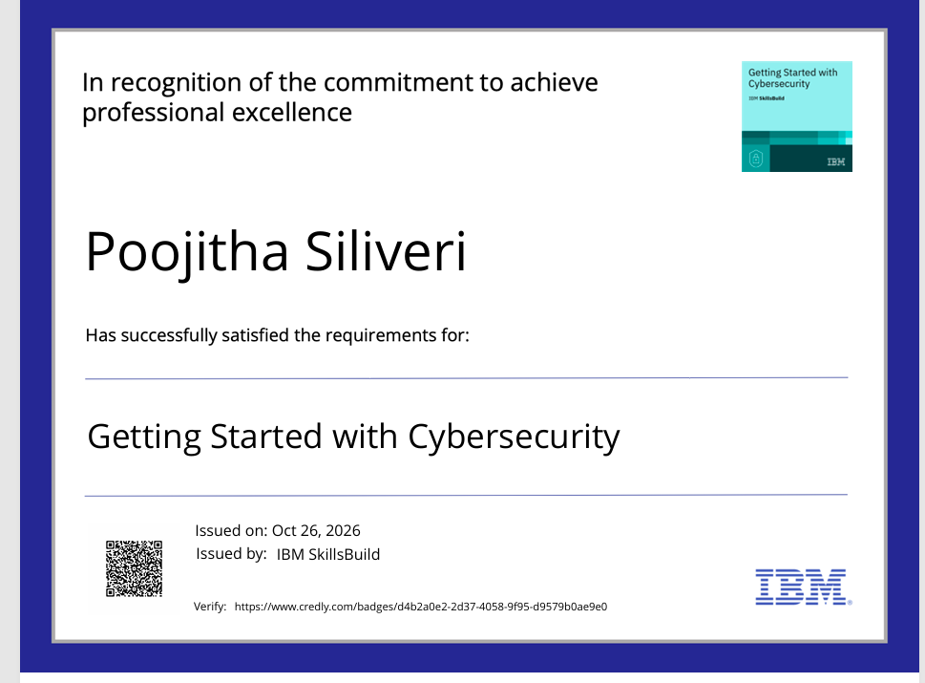
Certificates Earned:

Slide 16
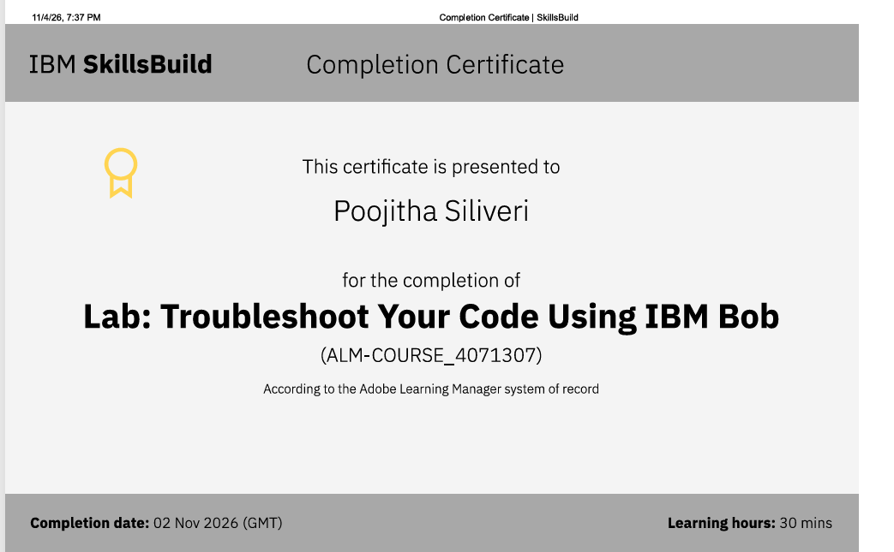
Certificates Earned:
IBM BOB Certificate

Slide 17
THANKYOU
TO EDUNET FOUNDATION AND IBM

